Slide 1
Progress in
Conversational Agents
and
Conversational Intelligence
Eric Saund
Conversational Human Agent Technologies Area
Interaction and Analytics Laboratory
January, 2017

Slide 3
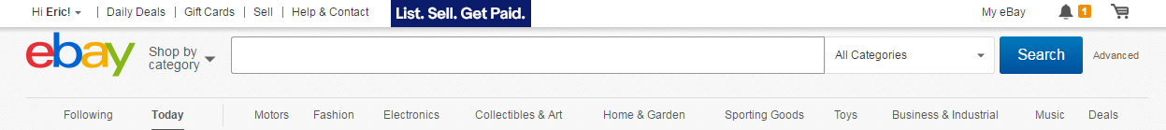
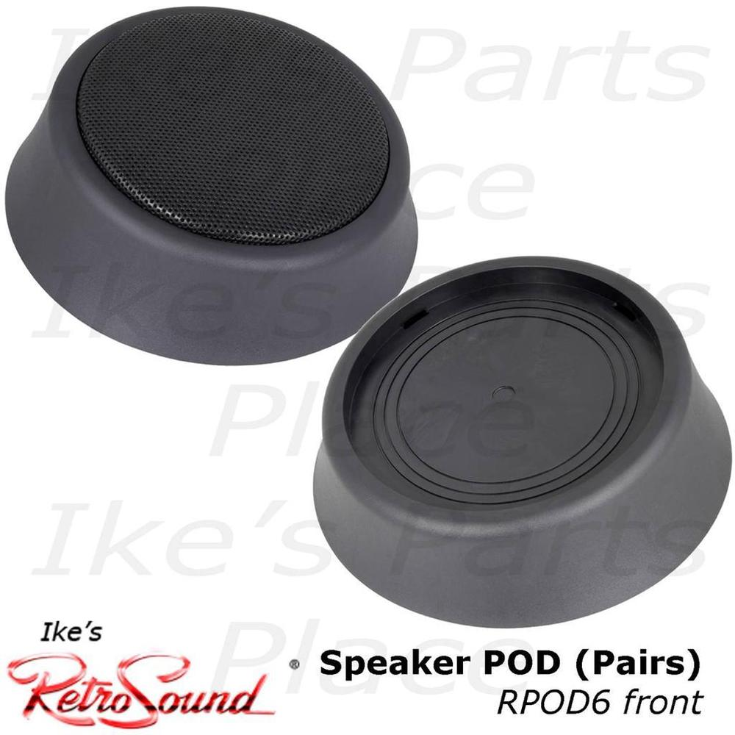
pod doors

Slide 4



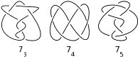

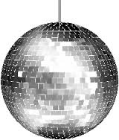



Goal: Wonderful Full-Featured Outcome

Slide 5
Evaluating Conversational Agents
Conversation
Naturalness
Human
Conversational
Agents
Speech/NL
User Interfaces
Phone tree
Knowledge Extent,
Reasoning Ability

Slide 6
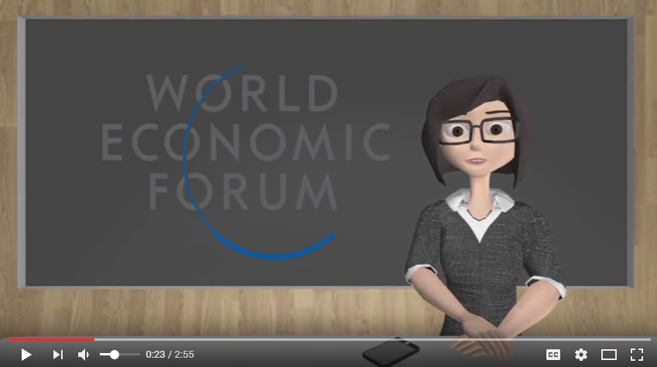
SARA (Socially Aware Robot Assistant) at the World Economic Forum
J. Cassell et al, Articulab, CMU
https://www.youtube.com/watch?v=cdGxk2RV_os

Slide 7
Heroic Leap Approach

Slide 8
Immaculate Plan Approach

Slide 9
Iterative Approach

Slide 10
Natural Language text
LogicalForm
Otto Information Flow
Template Rule
Object Property
Dialog Rule
Turn state value
Dialog Act
Interpretation Template Rules
Dialog Rules
Generation Template Rules
Knowledge Base
Active Dialog Rule and
Goal Priority List
(LHS)
(RHS)
Dialog Rule LHS Matcher:
Evaluate LHS conditions
to determine applicable
Dialog Rules
Execute
Dialog Rule RHS
Dialog State
Fact Base
Interpret
user utterance
Goal Stack
One Dialog Rule
fires at a time
Generate
agent utterance
Turn History
User
Utterance
Agent
Utterance
Turn State

Slide 11
Architecture of a Conversational Agent
ASR
(Automatic
Speech
Recognition)
NLP
(Natural
Language
Processing)
User
Utterance
Words
LogicalForm
Dialog Manager
Information State
-topic
-conversation history
-goals
-slot values
Knowledge Base
Business Rules
Reasoning Engine
LogicalForm
Words
Agent
Utterance
NLG
(Natural
Language
Generation)
TTS
(Text To Speech)

Slide 12
Dialog Manager
Natural
Language
Processing
Natural
Language
Generation
ASR
(Automatic
Speech
Recognition)
TTS
(Text To Speech)

Slide 13
Knowledge Compartmentalization (Modularity)
Domain
Knowledge
Dialog Manager
LogicalForm
LogicalForm
Linguistic
Knowledge
Natural
Language
Processing
Natural
Language
Generation
Words
Words
ASR
(Automatic
Speech
Recognition)
TTS
(Text To Speech)

Slide 14
NLP: From Words to LogicalForms (Meaning)
“What is Scott Elrod’s phone number?”
“What is extension for Scott in HSL?”
“Tell me Scott Elrod’s telephone number.”
“What do I dial to reach Scott Elrod?”
“What is the HSL lab manager’s number?”
Question-word
Intent terms
Command-word
Pattern Rule:
Person-word
{Question(WhatIs)} {Person}’s {X} ?
Organization-word
Entity terms
Address-book-item
LogicalForm:
Query(AddressBook(telephone-number, Person(Scott_Elrod))

Slide 15
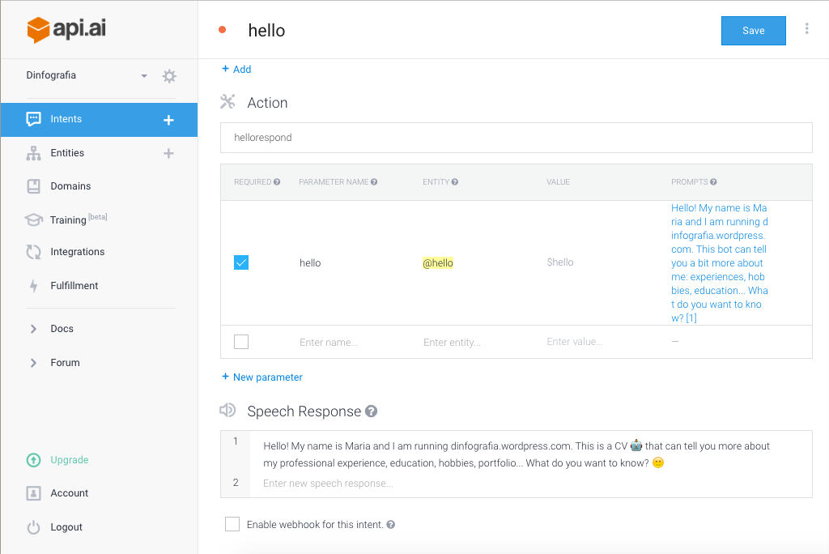
Developer Kits for Building Conversational Agents

Slide 16
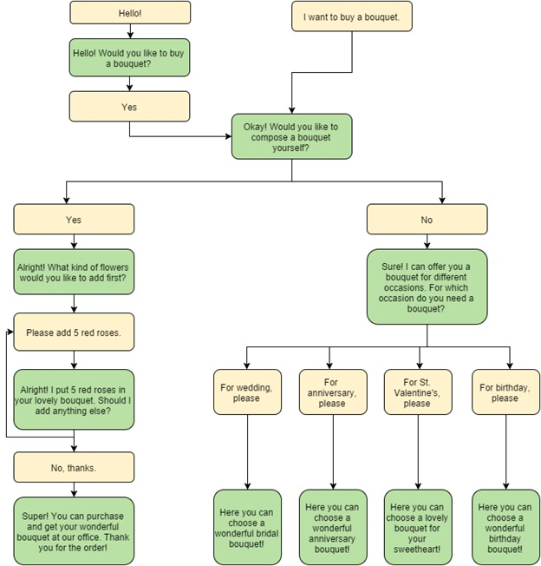
Design of Conversation Flows

Slide 17
Methodology: Compile Sample Dialogs
Starting questions for an office assistant agent.
How-Many Questions
Who-What Questions
“How many research fellows are in IAL?”
“How many direct reports does Jon Smith have?”
“How many indirect reports does Jon Smith have?”
“How many people are in the hardware labs?”
“How many researchers are in the hardware labs?”
“What are the areas of IAL?”
“Who is the manager of the CHAT Area?”
“Who is the lab manager of CHAT?”
“Who are the members of the CHAT Area?”
“What lab is the CHAT Area in?”
“What lab is Jon Smith in?”
“Who is Jon Smith’s admin?”
“Who is Jon Smith’s backup admin?”
“Who does Jon Smith report to?”
Change-knowledge assertions
“Jon Smith moved to the CHAT area”
“Jon Smith became the manager of the TWA Area”
“Jon Smith was promoted to Research Fellow”
“Jon Smith is now the backup admin for the TAO and ML Areas”
Yes-No Questions
“Are Jon Smith and Susan Jones in the same area?”
“Does Jon Smith report directly to Susan Jones?”
“Is Jon Smith Susan Jones’ admin?”
“Is Jon Smith in IAL?”
“Are Jon Smith and Susan Jones both MRS II’s?”
Quantification
“Are all of the members of CHAT in Pod 24?”
“Who are the managers of IAL’s areas?”
“Tell me the IAL lab managers.”
“Tell me the IAL managers and their budget centers.”
“Who in the CHAT lab uses Budget Center 1201?”
“Which CHAT members are managers?”
“Who in the CHAT area is an IAL lab manager?”

Slide 18
Scalability of Dialog Trees
U: “What are the areas of IAL?”
A: “The areas of IAL are HPA, CHAT, ML, and TAO.”
U: “What are the full names of the areas?”
U: “You’ve given me acronyms.”
U: “Which is the largest?”
U: “Is Kyle Dent manager of one of those?”
A: “There are four areas in IAL. Would you like me to list them?”
U: “Go ahead.”
U: “Wait let me get a pen.”
U: “Yeah but give me the full names, not acronyms.”
U: “I thought there were five.”

Slide 19
State of the Art in Conversational Agents
Dialog Manager
Conversational
Intelligence
NLP
(Natural
Language
Processing)
NLG
(Natural
Language
Generation)
SoA
ASR
(Automatic
Speech
Recognition)
TTS
(Text To Speech)

Slide 20
Evaluating Conversational Agents
Business Value in Office Applications
Conversation
Naturalness
Human
Chatbots
Conversational
Agents
PARC Otto
Speech/NL
User Interfaces
Alexa, Siri, Google
Phone tree
Knowledge Extent,
Reasoning Ability

Slide 21
Complementary Research Directions
Conversation
Naturalness
Human
State of the Art
Knowledge Extent,
Reasoning Ability

Slide 22
Complementary Research Directions
Conversation
Naturalness
Human
Cognitive Belief Modeling
State of the Art
Knowledge Extent,
Reasoning Ability

Slide 23

Natural Conversation

Slide 24
Natural Conversation
Turn Ownership
Topic Control
Pacing &
Data Chunk Size
Repair
Politeness
Readiness
Nonverbal
Vocalizations &
Cues
Baseline NLP
Conversation Analysis

Slide 25





Naturalistic Conversation
Turn Ownership
Topic Control
Pacing &
Data Chunk Size
Repair
Politeness
Readiness
Nonverbal
Vocalizations &
Cues
Conversation Analysis
Baseline NLP

Slide 26
Conversation Analysis Annotation of Tell-Phone-Number Dialog
U: what is the telephone number
A: area code six five zero
U: six five zero
A: eight one two
U: eight one three
A: i'll repeat that. the exchange is eight one two
U: eight
A: one
U: one
A: two
U: did you say nine?
A: no. it's two
U: did you say two?
A: yes. two
U: okay
A: the line number is four four seven four
U: what does line number mean?
A: the line number is the last four digits of the telephone number
U: okay
A: the line number is four four seven four
U: okay, got it
A: we're all done
initial query
inform topic data, include segment index
check echo (correct)
new topic data
check echo (incorrect)
disconfirmation, repeat topic data
check echo
repeat topic data, adjust chunk size
check echo
repeat topic data
confirmation request
correction, repeat topic data
confirmation request
confirmation, repeat of topic data
turn handoff
new topic data
request for topic data
new topic data in response to request
confirmation, turn handoff
repeat topic data, explicit segment index
confirmation, turn handoff
closing

Slide 27
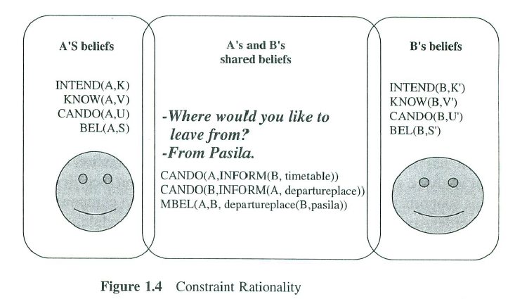
Common Ground
K. Jokinen, “Constructive Dialog Modeling”, 2009
H. Clark, 1985 (psycholinguistic theory)
D. Traum, 1993 (in a dialog manager)

Slide 28

Cognitive Belief Modeling
Situation of Interest
A’s Beliefs about situation
A’s Beliefs about B’s beliefs
B’s Beliefs about A’s beliefs
B’s Beliefs about situation

Slide 29
Modeling Belief in User’s Knowledge of Telephone Number
telephone number
A’s Beliefs about situation
area-code exchange line-number
6 5 0 8 1 2 4 4 7 4
0
1
2
3
4
5
6
7
8
9
0
1
2
3
4
5
6
7
8
9
0
1
2
3
4
5
6
7
8
9
0
1
2
3
4
5
6
7
8
9
0
1
2
3
4
5
6
7
8
9
0
1
2
3
4
5
6
7
8
9
0
1
2
3
4
5
6
7
8
9
0
1
2
3
4
5
6
7
8
9
0
1
2
3
4
5
6
7
8
9
0
1
2
3
4
5
6
7
8
9
A’s Beliefs about B’s beliefs
Distribution of belief that
user holds this number
as digit value.

Slide 30
Modeling Belief in User’s Knowledge of Telephone Number
telephone number
A’s Beliefs about situation
area-code exchange line-number
6 5 0 8 1 2 4 4 7 4
0
1
2
3
4
5
6
7
8
9
0
1
2
3
4
5
6
7
8
9
0
1
2
3
4
5
6
7
8
9
0
1
2
3
4
5
6
7
8
9
0
1
2
3
4
5
6
7
8
9
0
1
2
3
4
5
6
7
8
9
0
1
2
3
4
5
6
7
8
9
0
1
2
3
4
5
6
7
8
9
0
1
2
3
4
5
6
7
8
9
0
1
2
3
4
5
6
7
8
9
A’s Beliefs about B’s beliefs
Agent says: “six five zero”
Agent hears User echo: “six five zero”

Slide 31
Modeling Belief in User’s Knowledge of Telephone Number
telephone number
A’s Beliefs about situation
area-code exchange line-number
6 5 0 8 1 2 4 4 7 4
0
1
2
3
4
5
6
7
8
9
0
1
2
3
4
5
6
7
8
9
0
1
2
3
4
5
6
7
8
9
0
1
2
3
4
5
6
7
8
9
0
1
2
3
4
5
6
7
8
9
0
1
2
3
4
5
6
7
8
9
0
1
2
3
4
5
6
7
8
9
0
1
2
3
4
5
6
7
8
9
0
1
2
3
4
5
6
7
8
9
0
1
2
3
4
5
6
7
8
9
A’s Beliefs about B’s beliefs
Agent says: “eight one two”
Agent hears User echo: “eight one three”
Similarly for...
Readiness
Turn Ownership
Chunk Size

Slide 32
Tell-Phone-Number demo

Slide 33
Complementary Research Directions
Conversation
Naturalness
Human
Cognitive Belief Modeling
State of the Art
Knowledge Extent,
Reasoning Ability

Slide 34
Complementary Research Directions
Conversation
Naturalness
Human
Knowledge Graph Representation
State of the Art
Knowledge Extent,
Reasoning Ability

Slide 35
Org Chart Knowledge Base: Ontology Schema
reportsTo
firstName
( SL )
preferredName
( SL )
Person
lastName
( SL )
hasBudgetCenter
memberOf
headOf
BudgetCenter
budgetCenterName
( SL )
hasMember
budgetCenterNumber
( SL )
Organization
orgFullName
( SL )
orgAbbrevName
( SL )
isOrgUnitLevel
{ OrgUnitLevel_Area, OrgUnitLevel_Lab,
OrgUnitLevel_Center, OrgUnitLevel_Ops }
subOrganizationOf
hasSubOrganization
Location
Key
Object Type Name
propertyName
SL = String Literal value

Slide 36
Org Chart Knowledge Base: Data Example
Organization:
PARC
Knowledge Graph
subOrganizationOf
hasSubOrganization
IAL
orgName
Organization:
IAL_Lab
memberOf,
headOf
Person:
Raj_Minhas
subOrganizationOf
hasMember
hasSubOrganization
CHAT
orgName
Organization:
CHAT_Area
memberOf,
headOf
reportsTo
memberOf
hasMember
Person:
Kyle_Dent
memberOf
hasMember
hasMember
Person:
Jesse Vig
Person:
John_Maxwell
Key
reportsTo
reportsTo
Object Type Name
propertyName
SL = String Literal value

Slide 37
NLP: From Question to KB Query
“Who is manager of the CHAT Area?”
Question-word
Intent terms
Command-word
Pattern Rule:
Person-word
{Question(WhoIs)} {Relationship} {Org} ?
Organization-word
Entity terms
Relationship-word
LogicalForm:
Query( ManagerOf(Person(?), Organization(CHAT)))
SPARQL KB Query:
PREFIX foaf: <http://xmlns.com/foaf/0.1/>
SELECT ?name
WHERE { ?person a foaf:Person . ?person foaf:name ?name .
?area foaf:head ?person . ?area foaf:name “CHAT” }

Slide 38
Query as Subgraph Matching
Knowledge Graph
Query Graph
Organization:
PARC
“Who is manager of the CHAT Area?”
subOrganizationOf
hasSubOrganization
IAL
Organization:
IAL_Lab
orgName
memberOf,
headOf
Person:
Raj_Minhas
subOrganizationOf
hasMember
hasSubOrganization
CHAT
orgName
Organization:
CHAT_Area
memberOf,
headOf
reportsTo
memberOf
hasMember
Person:
Kyle_Dent
Organization
CHAT
memberOf
orgName
hasMember
hasMember
Mike
headOf
Person:
Jesse Vig
Person:
John_Maxwel
reportsTo
Roberts
reportsTo
Person:
?

Slide 39
Query Entity Ambiguity
“IAL manager”
LogicalForm alternative interpretations:
Query( ManagerOf(Person(?),
Org(IAL))
)
the manager of IAL
Query( And ( MemberOf (Person(?),
Org(IAL)),
ManagerOf (Person(?),
Org(λ))
)
)
a member of IAL
who is a manager

Slide 40
Pass Ambiguities Through Modular Interfaces
Domain
Knowledge
Dialog Manager
Linguistic
Knowledge
Natural
Language
Processing
Natural
Language
Generation
ASR
(Automatic
Speech
Recognition)
TTS
(Text To Speech)

Slide 41
Resolve Ambiguity by Exploiting Quantification in NL Expression
Domain
Knowledge
Dialog Manager
Cardinality
Linguistic
Knowledge
Quantification
Natural
Language
Processing
Natural
Language
Generation
ASR
(Automatic
Speech
Recognition)
TTS
(Text To Speech)

Slide 42
Quantification Constraint
“Tell me IAL’s manager.”
“Tell me IAL’s managers.”
Linguistic Quantification
Constraint
LogicalForm alternative interpretations:
Query( ManagerOf(Person(?),
Org(IAL))
)
ONE answer
vs.
MULTIPLE answers
Query( And ( MemberOf (Person(?),
Org(IAL)),
ManagerOf (Person(?),
Org(λ))
)
)

Slide 43
Determiners
Determiner
Definite
Definite Article “the”
Possessive
singular possessive ‘s
plural possessive s‘
Demonstrative
proximal singular “this”
proximal plural “these”
distal singular “that”
distal plural “those”
Indefinite
Indefinite Article “a” / “an”
“some”
Quantifier
“many”
“both”
“a few”
“most”
“all”
“several”
e.g. “one”, “two”, ...
Enumerator
“each”
“every”

Slide 44
Determiners Specify Set Cardinality
{definite-article} {entity-singular} the lab
{singular-possessive} {entity-singular} lab’s manager
{singular-demonstrative}{entity-singular} this lab
that lab
N = 1
Entity:
ONLY
{indefinite-article} {entity-singular} a lab
{indefinite-some} {entity-singular} some lab
N > 1
Entity:
ONE
{definite-article} {entity-plural} the labs
{singular-possessive}{entity-plural} lab’s managers
{plural-possessive} {entity-plural} labs’ managers
{plural-demonstrative}{entity-plural} these labs
those labs
{enumerator-each} {entity singular} each lab
{quantifier-all} {entity-plural} all labs
Entity:
N > 1
ALL
Entity:
N = 2
{quantifier-both} {entity-plural} both labs
ALL
Entity:
N =>2
{enumerator-every} {entity-singular} every lab
ALL
{quantifier-[quantity]} {entity-plural} a few labs
some labs
many labs
most labs
N labs
Entity:
N > 4
QUANTITY

Slide 45
Ambiguous Query Graphs with Cardinality Constraints
“Tell me IAL’s managers.”
DetPossessive( NP_Singular(NP_Nm(Prop(IAL))), NP_Plural(Comm(manager))
N = 1
N = 1
Organization
orgName
IAL
Organization
orgName
IAL
ONLY
ONLY
memberOf
headOf
N > 1
N > 1
Person
?
Person
?
ALL
ALL
headOf
N > 0
Organization

Slide 46
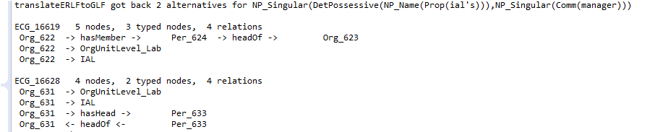
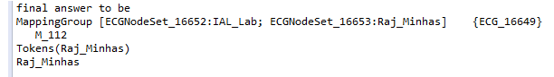
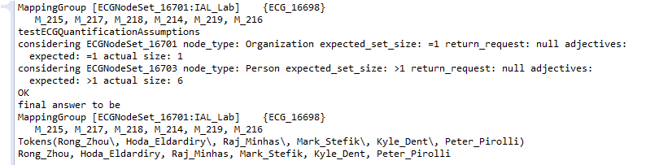
Working Example—Screen Shots

Slide 47
Opportunity
Dialog Manager
Conversational
Intelligence
NLP
(Natural
Language
Processing)
NLG
(Natural
Language
Generation)
ASR
(Automatic
Speech
Recognition)
TTS
(Text To Speech)

Slide 48
Conclusion
Conversation
Naturalness
Human
Cognitive Belief
Modeling
State of the Art
Knowledge Graph
Representation
Knowledge Extent,
Reasoning Ability

Slide 49
(fin)

Slide 52
Iterative Development

Slide 53
Pass Ambiguities through Modular Interfaces
Domain
Knowledge
Dialog Manager
Linguistic
Knowledge
Danger:
Ambiguity Explosion
Natural
Language
Processing
Natural
Language
Generation
ASR
(Automatic
Speech
Recognition)
TTS
(Text To Speech)

Slide 54
Reduce Ambiguity by Exploiting Quantification in NL Expression
Domain
Knowledge
Dialog Manager
Cardinality
Linguistic
Knowledge
Quantification
Natural
Language
Processing
Natural
Language
Generation
ASR
(Automatic
Speech
Recognition)
TTS
(Text To Speech)

Slide 55
Motivation
A conversational office assistant will need to draw upon knowledge of the workplace, including things like personnel, roles, and responsibilities, resources, and procedures.
Levels of Access:
Simple flat Q&A, only questions/answers explicitly listed in the database, e.g. “What is Jon Smith’s telephone number?”
Query contains logical conditions, e.g. “What are the Areas in IAL that have more than six people?”
Query requires inference, e.g. “Who can help me with my expense report?”
Modification of the knowledge base, requires authentication, e.g.: “Jon Smith has now moved to the CHAT area.”
Task requires inference knowledge base and access to other resources: “Check conference room availability near the IAL lab space”

Slide 56
Project Proposal Sketch
Knowledge Base of PARC Organization in an OWL Ontology
Conversational interfaces using Otto-type dialog management
Extend to:
additional PARC resources and services, e.g. Deltek, Outlook calendaring
process help
workflow assistance
Questions and Issues

Slide 57
Conversational Interfaces using Otto-type Dialog Management
Example simple (one-sentence) interactions based on org-chart knowledge:
How-Many Questions
Who-What Questions
“How many research fellows are in IAL?”
“How many direct reports does Jon Smith have?”
“How many indirect reports does Jon Smith have?”
“How many people are in the hardware labs?”
“How many researchers are in the hardware labs?”
“Who is the manager of the CHAT Area?”
“Who is the lab manager of CHAT?”
“Who are the members of the CHAT Area?”
“What lab is the CHAT Area in?”
“What lab is Jon Smith in?”
“Who is Jon Smith’s admin?”
“Who is Jon Smith’s backup admin?”
“What are the areas of IAL?”
“Who does Jon Smith report to?”
Change-knowledge assertions
“Jon Smith moved to the CHAT area”
“Jon Smith left PARC”
“Jon Smith became the manager of the TWA Area”
“Jon Smith was promoted to Research Fellow”
“Jon Smith is now the backup admin for the TAO and ML Areas”
Yes-No Questions
“Are Jon Smith and Susan Jones in the same area?”
“Does Jon Smith report directly to Susan Jones?”
“Is Jon Smith Susan Jones’ admin?”
“Is Jon Smith in IAL?”
“Are Jon Smith and Susan Jones both MRS II’s?”
Quantification
(New 11/17/2016)
“Are all of the members of CHAT in Pod 24?”
“Who are the managers of IAL’s areas?”
“Tell me the IAL lab managers.”
“Tell me the IAL managers and their budget centers.”
“Who in the CHAT lab uses Budget Center 1201?”
“Which CHAT members are managers?”
“Who in the CHAT area is an IAL lab manager?”
Let’s Exclude...
“How many indirect reports does John Smith have who moved from IAL to SSL on a Thursday in 2015 when the Indian Chef was featured in the cafeteria?”

Slide 58
Update Topics
The OrgTasks KB
structure
maintenance
Otto access
Considerations & representative examples
formulas and λ-expressions
Options for structuring Otto rules
KB Interface functions
Named Entities
Strong vs Weak Typing
Query graph
Other interesting issues

Slide 59
Evaluating Conversational Agents
Conversation
Naturalness
Human
Chatbots
Conversational
Agents
PARC Otto
Speech/NL
User Interfaces
Alexa, Siri, Google
Phone tree
Knowledge Extent,
Reasoning Ability

Slide 60
Naturalistic Conversation

Slide 61
OrgTasks Knowledge Base: Maintenance
PARC Databases
(SQL Server)
App Maintainer Data Tables
OrgTasks_PARC KB
Server name: TIMON
database name: BusApps
db view: ConvoAgentView
ottoOrgStructure_PARC.csv
ottoPersonnelStructure_PARC.csv
ottoAccountStructure_PARC.csv
PARC/orgTasks-kb-rdf-rev.xml
ConvertOttoOrgTasksKBFileToOrgDataTables
RetrieveOrgDataWriteToCSVFiles
ConvertOttoOrgDataTablesToOrgTasksKBFile
OrgTasks_Seed KB
orgTasks-kb-rdf.xml
Protege

Slide 62
OrgTasks Knowledge Base: Otto Access
public interface KnowledgeBase
public class SimpleKB
public class SPARQL_OWL_KB
Most Otto apps John has written
New, for orgTasks app
public class SPARQLKB
public class SQL_DB_ACCESS
Old, for telco app? only
New, for accessing the PARC SQL Server
for KB initialization & synchronization
with PARC Bus Apps.

Slide 64
Considerations & Representative Examples (1)
Person:
?
Organization: CHAT_Area
“Who are the members of CHAT?”
memberOf
hasMember
Organization: CHAT_Area
Person:
?
getInstances(Person, memberOf, CHAT_Area)
getPropValues(CHAT_Area, hasMember)
Person:
?
Person:
Kyle_Dent
reportsTo
reportsTo
Person:
Kyle_Dent
Person:
?
“Who reports to Kyle Dent?”
“Who does Kyle Dent report to?”

Slide 65
Considerations & Representative Examples (2)
Person:
Mike_Roberts
“What group is Mike Roberts in?”
memberOf
Organization: ?
getPropValues(Mike_Roberts, memberOf)
Person:
Mike_Roberts
“What area is Mike Roberts in?”
memberOf
Organization: ?
OrgUnitLevel_Area
isOrgUnitLevel
Org_? = getPropValues(Mike_Roberts, memberOf)
getPropValue(Org_?, isOrgUnitLevel) = OrgUnitLevel_Area

Slide 66
Considerations & Representative Examples (1, λ)
Except really...
Person:
?
Organization:
λ
CHAT
hasAbbrevName
“Who are the members of CHAT?”
memberOf
hasMember
Organization:
λ
CHAT
Person:
?
hasAbbrevName
Person_? = getInstances(Person, memberOf, λ)
Person_? = getPropValues(λ, hasMember)
getPropValue(λ, hasAbbrevName) = CHAT
getPropValue(λ, hasAbbrevName) = CHAT
Person:
?
Person:
λ
firstName
Kyle
lastName
Dent
reportsTo
reportsTo
Person:
λ
firstName
Kyle
Person:
?
lastName
Dent
“Who reports to Kyle Dent?”
“Who does Kyle Dent report to?”

Slide 67
Considerations & Representative Examples (2, λ)
Person:
λ
firstName
Mike
lastName
Roberts
“What group is Mike Roberts in?”
memberOf
Organization: ?
Org_? = getPropValues(Person_λ, memberOf)
getPropValues(Person_λ, firstName)= Mike
getPropValues(Person_λ, lastName)= Roberts
Person:
λ
firstName
Mike
“What area is Mike Roberts in?”
lastName
Roberts
memberOf
Organization: ?
OrgUnitLevel_Area
isOrgUnitLevel
Org_? = getPropValues(Person_λ, memberOf)
getPropValue(Org_?, isOrgUnitLevel) = OrgUnitLevel_Area
getPropValues(Person_λ, firstName)= Mike
getPropValues(Person_λ, lastName)= Roberts

Slide 68
Considerations & Representative Examples (3, λ)
“What area managers are in the same pod as their lab manager?”
Location:
λ5
locatedIn
Person:
?1
headOf
Organization:
λ2
isOrgUnitLevel
orgUnitLevel_Area
locPod
podID_λ6
reportsTo
locPod
Location:
λ7
locatedIn
Person:
λ3
headOf
Organization:
λ4
isOrgUnitLevel
orgUnitLevel_Lab
Person_?1 = getInstances(Person, headOf, Organization_λ2)
getPropValues(Organization_λ2, isOrgUnitLevel) = orgUnitLevel_Area
getPropValues(Person_?1, reportsTo) = Person_λ3
getPropValues(Person_λ3, headOf) = Organization_λ4
getPropValues(Organization_λ4, isOrgUnitLevel) = orgUnitLevel_Lab
getPropValues(Person_?1, locatedIn) = Location_λ5
getPropValues(Person_λ3, locatedIn) = Location_λ7
getPropValue(Location_λ5, locationPod) = podID_λ6
getPropValue(Location_λ7, locationPod) = podID_λ6

Slide 69
Otto Rules (1)
“Who are the members of CHAT?”
1. Interpreter Template Rule
User: Ask(WhoAreMembersOf(Organization($1))) <- Who are the members of {OrganizationCat[$1]}?
OrganizationCat[$1] <-> CHAT
2. Dialog Rule
rank(30): Ask(WhoAreMembersOf(Organization($1))) => getMembers(Organization($1), $2)
Inform(Reply($2))
PersonList(“Mike, John, Kyle, Jesse, Eric”)
3. Generator Template Rule
Agent: Inform(Reply(PersonList($3))) -> The members are {$3}

Slide 70
Otto Rules (2)
“Who reports to Kyle Dent?”
1. Interpreter Template Rule
User: Ask(WhoReportsToPerson(Person($1))) <- Who reports to {PersonCat[$1]}?
PersonCat[$1] <-> Kyle Dent
2. Dialog Rule
rank(30): Ask(WhoReportsToPerson(Person($1))) => getWhoReportsTo(Person($1), $2)
Inform(Reply($2))
PersonList(“Mike, John, Kyle, Jesse, Eric”)
3. Generator Template Rule
Agent: Inform(Reply(PersonList($3))) -> The members are {$3}

Slide 71
Otto Rules: Referring to Entities Option 1a
“Who reports to Kyle?”
1. Interpreter Template Rule
1a
User: Ask(WhoReportsToPerson(Person($1))) <- Who reports to {FirstNameCat[$1]}?
User: Ask(WhoReportsToPerson(Person($1))) <- Who reports to {PreferredNameCat[$1]}?
User: Ask(WhoReportsToPerson(Person($1))) <- Who reports to {FirstNameLastNameCat[$1]}?
User: Ask(WhoReportsToPerson(Person($1))) <- Who reports to {PreferredNameLastNameCat[$1]}?
User: Ask(WhoReportsToPerson(Person($1))) <- Who reports to {LastNameCat[$1]}?
FirstNameCat[stephen] <-> Stephen
PreferredNameCat[steve] <-> Steve
FirstNameLastNameCat[stephen_hoover] <-> Stephen Hoover
PreferredNameLastNameCat[steve_hoover] <-> Steve Hoover
LastNameCat[hoover] <-> Hoover

Slide 72
Otto Rules: Referring to Entities Option 1b
“Who reports to Kyle?”
1. Interpreter Template Rule
1b
User: Ask(WhoReportsToPerson(Person($1))) <- Who reports to {NameCat[$1]}?
NameCat[steve_hoover] <-> Steve
NameCat[steve_hoover] <-> Stephen
NameCat[steve_hoover] <-> Steve Hoover
NameCat[steve_hoover] <-> Stephen Hoover
NameCat[steve_hoover] <-> Hoover
.
.
.
NameCat[steve_smith] <-> Steve
NameCat[steve_jones] <-> Steve
NameCat[steve_anderson] <-> Steve
NameCat[steve_bradley] <-> Steve

Slide 73
Otto Rules: Referring to Entities Option 1c
“Who reports to Kyle?”
1. Interpreter Template Rule
1c
User: Ask(WhoReportsToPerson(Person($1))) <- Who reports to {PersonCat[$1]}?
KB:
Person_SteveHoover.name = Steve Hoover
Person_SteveHoover.alias = Stephen Hoover
Person_SteveHoover.alias = Steve
Person_SteveHoover.alias = Stephen
Person_SteveHoover.alias = Hoover
.
.
.
Person_SteveSmith.alias = Steve
Person_SteveJones.alias = Steve
Person_SteveAnderson.alias = Steve
Person_SteveBradley.alias = Steve
JTM’s recommended method:
DIRECT naming.
Applies to proper nouns only.
Can produce ambiguity in the person referenced, expressed
in an Ambiguity(...) LogicalForm

Slide 74
Topics
Relational graph semantics
Referring to entities: DIRECT, INDIRECT
Otto Classic approach: HasProp, ValueOf
Queries not handled by recursive search
Entities and Sets
Determiners
Sequences of Noun Forms
NounPhrases among Relation words
Assembing a query
LogicalForm architecture

Slide 75
Otto Classic Expressions: HasProp and ValueOf
Set(entity-x) HasProp( propName, Set(propValue) )
x-domain
entity-x
HasProp(propName, Set(propValue)):
return Set(entity-x) : forAny(entity-x in Set(x-domain)
forAny(propValue in Set(propValue)
Rel(entity-x, propName, propValue) == True)
ALL
propName
propValue
ANY
Set(entity-x) ValueOf( Set(entity-y), propName)
entity-y
ValueOf(Set(entity-y), propName):
return Set(entity-x) : forAny(entity-x in Set(x-domain)
forAny(entity-y in Set(entity-y)
Rel(entity-y, propName, entity-x) == True)
ANY
propName
x-domain
entity-x
ALL

Slide 76
Set Notation (1) (more later)
Entity:
ALL
Subset referenced by the speaker.
Example: “Who is located in Pod 24?”

Slide 77
Entities and Property Constraint Relations (Otto Classic)
“What area managers are in the same pod as their lab manager?”
Location:
λ5
locatedIn
Person:
?1
headOf
Organization:
λ2
isOrgUnitLevel
orgUnitLevel_Area
locPod
podID_λ6
reportsTo
locPod
Location:
λ7
locatedIn
Person:
λ3
headOf
Organization:
λ4
isOrgUnitLevel
orgUnitLevel_Lab
Ask(OrgChartQuery(Person(ValueOf(Organization(HasProp(isOrgUnitLevel,
orgUnitLevel_Area)), headOf), HasProp(locatedInPod, Person(ValueOf(Person(ValueOf(Person(Pronoun(their)),
personsLabManager)), locatedInPod))), ?))
TypeName(HasProp(...)) and
TypeName(ValueOf(...)) set domain-x to the universe of objects of type TypeName

Slide 78
Referring to Entities and Property Relations
“What area managers are in the same pod as their lab manager?”
Structured English:
What is the Set of entities which
-is an area manager
-is in a pod λ5
-has a their relationship with an entity λ3
-entity λ3 is a lab manager
-entity λ3 is in a pod λ7
-pod λ5 is has a same relationship with pod λ7
Big challenge to write template rules to decompose linguistic structure and re-compose
semantic structure at this level of sophistication.
N >= 0
in
Entity:
?
is
pod λ5
ALL
area manager
same
their
pod λ7
lab manager
Entity:
λ3
in
is

Slide 79
Queries That Don’t Map to Simple Recursive Mapping
“What area managers are in the same pod as their lab manager?”
“List some of IAL’s budget centers.”
“What is the IAL lab manager’s budget center?”
“What are the IAL lab manager’s budget centers?”
“List both of the IAL lab manager’s budget centers.”
“What are the IAL area managers’ budget centers?”
“What are the IAL lab managers’ budget centers?”
“What are the IAL lab’s managers’ budget centers?”
“What is the IAL managers’ budget center?”
“Tell me the IAL managers and their budget centers.”
“Which area managers’ printer is the same as their lab manager?”
“List the lab members far from a color printer.”
“Tell me the admin who handles Beech.”
“Which admin handles either printer Beech or Ocean?”
“Which admins handles the printers Beech and Ocean?”
“Is there any admin who handles both Beech and Ocean?”
“Tell me the lab members in Pod 24 near Mali.”
“Which IAL members are closer to Joy and who is closer to Mali?”
“Is ICM on the second floor or first?”
“Is IAL’s membership all in Pods 24, 25, or 26?”
“Is most of IAL’s membership in Pod 24?”
“Is there anyone at PARC who has their own budget center?”
Linguistic & semantic quantification
Closed loops in the query graph
Multiple return values

Slide 80
Set Notation (2)
N >= 0
Set expected size, expresses speaker’s belief
about the set they are referring to.
Entity:
ALL
Subset referenced by the speaker.
Example: “List all of the members of IAL.”
Sets
plurality
selection among a multiplicity
“Who is IAL’s manager?” == “Who is head of the IAL lab?”
“Who are IAL’s managers?” == “List the managers who are members of IAL.”
It will be necessary to represent sets in order to interpret these queries correctly.

Slide 81
Conversational Interfaces using Otto-type Dialog Management
Map between N.L. expressions and SPARQL expressions
PREFIX foaf: <http://xmlns.com/foaf/0.1/>
SELECT ?name
WHERE { ?person a foaf:Person . ?person foaf:name ?name .
?area foaf:head ?person . ?area foaf:name “CHAT” }
Maintain conversation context to resolve pronouns, ambiguities. “Is Jon Smith in that lab” “Is he in EMDL?” “Does he report to Jon Smith?” “Who else is in that area?”
Naturalistic conversational dialog management, to establish belief grounding in communication of structured data---extend Tell-Phone-Number prototype
Multiple D.M. portals -chatbot (Slack, texting) -spoken conversational (Echo, telephone)
Permissions to change data in the knowledge base through Conversational Call-Back Authentication
“Who is the manager of CHAT?”

Slide 82
Sequences of Noun Forms (1)
Forms
Noun Forms:
entity-singular lab
entity-plural labs
singular-possessive lab’s
plural-possessive labs’
possessive plural
Proper IAL
entity name => type + all other properties
Common lab
entity descriptor => type (sometimes) + some other properties
Goal:
“What are the IAL lab manager’s budget centers?”

Slide 83
Sequences of Noun Forms (2)
Sequences
Noun Phrase (NP):
NP_Name(Prop(IAL)) IAL
NP_Singular(Comm(lab)) lab
NP_Plural(Comm(lab)) labs
NP <- NP_Name
NP <- NP_Singular
NP <- NP_Plural
NP_Singular ( NP, NP, ..., NP_Singular) <- {NP} {NP} ... {NP_Singular)
NP_Plural (NP, NP, NP, ... NP_Plural) <- {NP} {NP} ... {NP_Plural}
Abbeviated
NP_Nm
NP_Sn
NP_Pl
“IAL lab manager” : NP_Singular( NP_Name(Prop(IAL)), NP_Singular(Comm(lab)), NP_Singular(Comm(manager)) )
“IAL area managers” : NP_Plural( NP_Name(Prop(IAL)), NP_Singular(Comm(area)), NP_Plural(Comm(manager)) )
Abbeviated
“IAL lab manager” : NP_Sn( NP_Nm(Prop(IAL)), NP_Sn(Comm(lab)), NP_Sn(Comm(manager)) )
“IAL area managers” : NP_Pl( NP_Nm(Prop(IAL)), NP_Sn(Comm(area)), NP_Pl(Comm(manager)) )

Slide 84
Sequences of Noun Forms (3)
Possessive Form
Possessive Determiners:
DetPossessive(NP_Name(Prop(IAL))) IAL’s
DetPossessive(NP_Singular(Comm(lab))) lab’s
DetPossessive(NP_Plural(Comm(lab))) labs’
DetPossessive(NP_Singular(...))
DetPossessive(NP_Plural(...))
IAL lab manager's DetPossessive( NP_Singular(NP_Nm(Prop(IAL)), NP_Sn(Comm(lab)), NP_Sn(Comm(manager))) )
IAL lab managers' DetPossessive( NP_Plural(NP_Nm(Prop(IAL)), SN_Sn(Comm(lab)), NP_Pl(Comm(manager))) )

Slide 85
Sequences of Noun Forms (4)
Entity Possessed
The entity which is possessed
NP_Singular(DetPossessive(NP_Singular), NP_Singular) <- {DetPossessive(NP_Singular)} {NP_Singular}
IAL lab manager's budget-center
NP_Singular( DetPossessive( NP_Singular(NP_Nm(Prop(IAL)), NP_Sn(Comm(lab)), NP_Sn(Comm(manager)) ),
NP_Singular(Comm(budget-center)) )
NP_Plural(DetPossessive(NP_Singular), NP_Plural) <- {DetPossessive(NP_Singular)} {NP_Pural}
IAL lab manager's budget-centers
NP_Plural( DetPossessive( NP_Singular(NP_Nm(Prop(IAL)), NP_Sn(Comm(lab)), NP_Sn(Comm(manager)) ),
NP_Plural(Comm(budget-center)) )
NP_Singular(DetPossessive(NP_Plural), NP_Singular) <- {DetPossessive(NP_Plural)} {NP_Singular}
IAL lab managers’ budget-center
NP_Singular( DetPossessive( NP_Plural(NP_Nm(Prop(IAL)), NP_Sn(Comm(lab)), NP_Pl(Comm(manager)) ),
NP_Singular(Comm(budget-center)) )
NP_Plural(DetPossessive(NP_Plural), NP_Plural) <- {DetPossessive(NP_Plural)} {NP_Plural}
IAL lab managers’ budget-centers
NP_Plural( DetPossessive( NP_Plural(NP_Nm(Prop(IAL)), NP_Sn(Comm(lab)), NP_Pl(Comm(manager)) ),
NP_Plural(Comm(budget-center)) )

Slide 86
Sequences of Noun Forms (5)
Semantic Representation
The possessive form induces a property relation.
IAL lab manager's DetPossessive( NP_Singular(NP_Nm(Prop(IAL)), NP_Sn(Comm(lab)), NP_Sn(Comm(manager)) )
IAL, lab, manager
λ
Entity(Descriptors(Prop(IAL), Comm(lab), Comm(manager))
possesses
IAL lab manager's budget-centers
NP_Plural( DetPossessive( NP_Singular(NP_Nm(Prop(IAL)), NP_Sn(Comm(lab)), NP_Sn(Comm(manager)) ),
NP_Plural(Comm(budget-center)) )
IAL, lab, manager
λ
Entity(Descriptors(Prop(IAL), Comm(lab), Comm(manager)))
possesses
N > 1
budget center
?
EntitySet( Descriptors(Comm(budget-center)),
N > 1,
UNSPECIFIED)

Slide 87
Sequences of Noun Forms (6)
Semantic Representation
IAL lab managers’ budget-center
NP_Singular( DetPossessive( NP_Plural(NP_Nm(Prop(IAL)), NP_Sn(Comm(lab)), NP_Pl(Comm(manager)) ),
NP_Singular(Comm(budget-center)) )
N > 1
IAL, lab. manager
λ
EntitySet(Descriptors(Prop(IAL), Comm(lab), Comm(manager)),
N > 1,
UNSPECIFIED)
possesses
N = 1
budget center
?
EntitySet( Descriptors(Comm(budget-center)),
N = 1,
ONLY)

Slide 88
Sequences of Noun Forms (7)
Semantic Representation
IAL lab managers’ budget-centers
NP_Plural( DetPossessive( NP_Plural(NP_Nm(Prop(IAL)), NP_Sn(Comm(lab)), NP_Pl(Comm(manager)) ),
NP_Plural(Comm(budget-center)) )
N > 1
IAL, lab, manager
λ
EntitySet(Descriptors(Prop(IAL), Comm(lab), Comm(manager)),
N > 1,
UNSPECIFIED)
possesses
N > 1
budget center
?
EntitySet( Descriptors(Comm(budget-center)),
N > 1,
UNSPECIFIED)

Slide 89
Sequences of Noun Forms (8)
Article Determiners
budget centers NP_Plural(Comm(budget-center))
N > 1
budget center λ
EntitySet(Descriptors(Comm(budget-center)),
N > 1,
UNSPECIFIED)
the budget centers DefiniteArticle( NP_Plural(Comm(budget-center)) )
N > 1
budget center λ
EntitySet(Descriptors(Comm(budget-center)),
N > 1,
ALL)
ALL
a budget center IndefiniteArticle( NP_Plural(Comm(budget-center)) )
N > 1
budget center λ
EntitySet(Descriptors(Comm(budget-center)),
N > 1,
ONE)
ONE

Slide 90
Sequences of Noun Forms (9)
Article Determiners in a Noun Sequence
NP(NP_1, NP_2, .., NP(Det(NP_n))) <- {Det} { NP( NP_1, NP_2, ... NP_n) }
the IAL budget centers
DefiniteArticle NP_Plural(NP_Name(Prop(IAL)), NP_Plural(Comm(budget-center))) =>
NP_Plural( NP_Name(Prop(IAL)), NP_Plural(DetfiniteArticle(NP_Plural(Comm(budget-center)))) )
N > 1
IAL,
budget center
λ
EntitySet(Descriptors(Prop(IAL), Comm(budget-center)),
N > 1, ALL)
ALL

Slide 91
Assembling the Query (1): Query Graph & LogicalForm
“What are the IAL lab manager’s budget centers?”
NP_Plural( DetPossessive( NP_Singular(NP_Nm(Prop(IAL)), NP_Sn(Comm(lab)), NP_Sn(Comm(manager)) ),
NP_Plural(DefiniteArticle(NP_Pl(Comm(budget-center)))) )
EntitySet(Descriptors(Prop(IAL), Comm(lab), Comm(manager)),
N = 1,
ONLY)
N = 1
IAL, lab, manager
λ
ONLY
possesses
N > 1
EntitySet(Descriptors(Comm(budget center)),
N > 1,
ALL)
budget center
?
ALL

Slide 92
Assembling the Query (2): Query Graph & LogicalForm
“What are the IAL lab manager’s budget centers?”
NP_Plural( DetPossessive( NP_Singular(NP_Nm(Prop(IAL)), NP_Sn(Comm(lab)), NP_Sn(Comm(manager)) ),
NP_Plural(DefiniteArticle(NP_Pl(Comm(budget-center)))) )
EntitySet(Descriptors(Prop(IAL), Comm(lab), Comm(manager)),
N = 1,
ONLY)
N = 1
IAL, lab, manager
λ
ONLY
possesses
N > 1
EntitySet(Descriptors(Comm(budget center)),
N > 1,
ALL)
budget center
?
ALL

Slide 93
Assembling the Query (3): Multiple Return Values
“Tell me the IAL managers and their budget centers”
Request(?1, ?2)( NP_Plural(?1, DefiniteArticle(NP_Pl(NP_Nm(Prop(IAL)), NP_Pl(Comm(manager)) ),
NP_Plural(?2, Comm(budget-center)),
Relation(?1, possesses, ?2))
Linguistic Deconstruction LF Interpretation
EntitySet(Descriptors(Prop(IAL), Comm(manager)),
N > 1,
ALL)
Mentalese LF Interpretation:
LF representation of
sets, graph relations
N > 1
IAL,
manager
?1
ALL
possesses
N > 1
EntitySet(Descriptors(Comm(budget center)),
N > 1,
ALL)
budget center
?2
ALL

Slide 94
Linguistic Deconstruction of Other Query Patterns (1)
What area managers are in the same pod as their lab manager?
VP(Vb_Pl_Pr(is),
Relation(in))
Comparator(same)
NP_Sn(NP_Pr(their),
NP_Sn(Comm(lab)),
NP_Sn(Comm(manager))
NP_Pl(NP_Sn(Comm(area)),
NP_Pl(Comm(manager))
Coordinator(as)
NP_Sn(DefinteArticle(NP_Sn(Comm(pod))))
Relation(possesses)
{entity-λ1} {relation} {comparator} {entity-λ2} {coordinator} {relation} {entity-λ3}
N >= 0
area, manager
?1
in
pod
λ2
ALL
possesses
same
!
lab, manager
λ3

Slide 95
Linguistic Deconstruction of Other Query Patterns (2)
Solution 1: Syntactic
The relationship (in pod) distributes to the object.
What area managers are in the same pod as their lab manager?
[in pod ]
Rel(x, in, pod)
Rel(x, in, pod)
Solution 2: Semantic
The relationship Rel(Person(x), in, pod) is detected as applicable to the other Person object.
N >= 0
area, manager
?1
in
pod
λ2
ALL
same
same
possesses
lab, manager
λ3
in
pod
λ4

Slide 96
Linguistic Deconstruction of Other Query Patterns (3)
What area managers are in the same pod as their lab manager?
{entity-λ1} {relation} {comparator} {entity-λ2} {coordinator} {relation} {entity-λ3}
What area managers are in the same pod as the printer?
Which samsung device has a larger screen than the iphone 4?
{entity-λ1} {relation} {comparator} {entity-λ2} {coordinator} {entity-λ3}
Which samsung device has a screen larger than the iphone 4?
{entity-λ1} {relation} {entity-λ2} {comparator} {coordinator} {entity-λ3}
Which samsung device costs more than the iphone 4?
{entity-λ1} {relation} {comparator} {coordinator} {entity-λ2}

Slide 97
LogicalForm Architecture
Input utterance (many equivalent forms)
Otto Classic
Otto Classic LF Interpretation
Linguistic Deconstruction LF Interpretation
DM
Mentalese LF Interpretation (graph, sets)
RE / DM
Internal Java object structure (graphs, sets)
past dialog
(mentalese LF)
sentence complexity
verbosity
pronouns +/-
models of user
knowledge
mirror
Java function
(recursive db queries)
Reasoning Engine (graph search, +...)
Internal Java object structure (graphs, sets)
Mentalese LF Response (graph, sets)
Otto Classic
DM
Otto Classic LF Response
Response Linguistic Construction LF
Response utterance (mirror of input utterance)
Response utterance (many forms)

Slide 98
Otto Rules: Referring to Entities

Slide 99
Extreme Weak Entity Typing
EntityCat <- Kyle
EntityCat <- Kyle
EntityCat <- Kyle Dent
EntityCat <- Kyle Dent
EntityCat <- Dent
EntityCat <- person
EntityCat <- man
EntityCat <- woman
EntityCat <- him
EntityCat <- her
EntityCat <- IAL
EntityCat <- group
EntityCat <- lab
EntityCat <- 1601
EntityCat <- budget center 1601
person name
generic person
attributed person
pronouns
organization name
generic organization
attributed organization
.
.
.
Current exploration:
Weak Entity Typing: pass ambiguity on to the reasoning side and let
semantic knowledge figure it out.
Handle KB queries by graph matching.

Slide 100
Query Graphs (1)
Entities map to subgraphs
What area is Mike Roberts a member of?
Person:
λ
firstName
Mike
EntityCat <- Mike Roberts
lastName
Roberts
(hardwired in the
template rule)
member of
memberOf
EntityCat <- area
Organization: ?
OrgUnitLevel_Area
isOrgUnitLevel
User: Ask(AskQ(AnswerType(PropertyValue(Organization)), Qualifications(PropertyConstraint(SubjectEntityIndicator($1), \
PropertyName(memberOf), \
ValueEntityIndicator($3))))) \
<- What {EntityIndicatorCat[$3]} is {EntityIndicatorCat[$1]} a member of?

Slide 101
Query Graphs (2)
User: Ask(AskQ(AnswerType(PropertyValue(Organization)), Qualifications(PropertyConstraint(SubjectEntityIndicator($1), \
PropertyName(memberOf), \
ValueEntityIndicator($3))))) \
<- What {EntityIndicatorCat[$3]} is {EntityIndicatorCat[$1]} a member of?
rank(30) Ask(AskQ(AnswerType($4), Qualifications(PropertyConstraint(SubjectEntityIndicator($1), \
PropertyName($2), \
ValueEntityIndicator($3))))
=> retrieveQualifiedItems(SubjectEntityIndicator($1), \
PropertyName($2), \
ValueEntityIndicator($3), \
AnswerRequestSpec($4), \
$81, $82, $83, $95) \
Set(User(Inform(HandleReply_What1HasProperty2Value3($81, $82, $83,
AnswerRequestSpec($4), $95))))
resolved subject
resolved property
resolved value
pass-thru what the question was
answer

Slide 102
Other Interesting Issues

Slide 103
Organization:
PARC
subOrganizationOf
hasSubOrganization
isOrgUnitLevel
Organization:
IAL_Lab
memberOf,
headOf
Person:
Raj_Minhas
subOrganizationOf
hasMember
Person:
λ
firstName
Mike
hasSubOrganization
lastName
Roberts
OrgUnitLevel_Area
isOrgUnitLevel
Organization:
CHAT_Area
memberOf,
headOf
reportsTo
memberOf
Organization ?
OrgUnitLevel_Area
memberOf
hasMember
Person:
Kyle_Dent
isOrgUnitLevel
memberOf
hasMember
hasMember
Person:
Mike_Roberts
Person:
John_Maxwel
reportsTo
reportsTo

Slide 104
(Slides from the original project proposal presentation)

Slide 105
Other Factors
Transparent AI
Agent should be able to
interact at different levels of detail and granularity
ask clarification questions
explain its answers

Slide 106
Knowledge Base (1)
Suggestion: An OWL Ontology Knowledge Base
Start with the PARC Org Chart
Use The Organization Ontology
W3C Recommendation 16 January 2014
https://www.w3.org/TR/2014/REC-vocab-org-20140116/
Edit manually with Protege
Use HermiT inference engine
Access programmatically with SPARQL / SPARUL (SPARQL Update)
Jena, AllegroGraph
Pellet

Slide 107
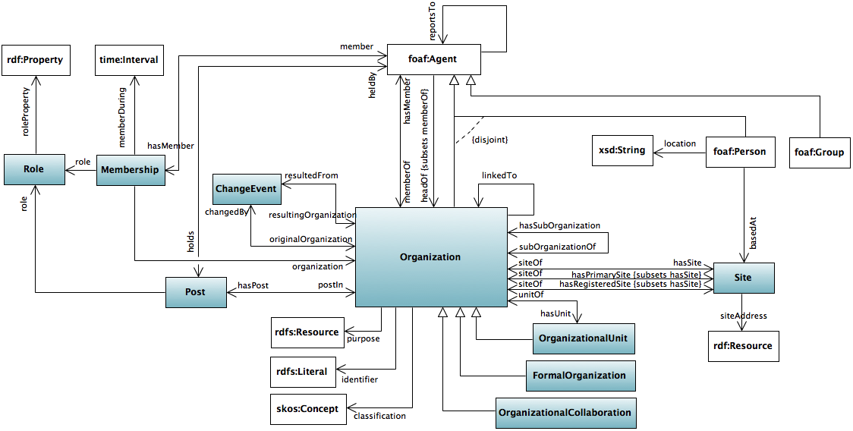
Knowledge Base (2)
Use The Organization Ontology
W3C Recommendation 16 January 2014
https://www.w3.org/TR/2014/REC-vocab-org-20140116/

Slide 108
Knowledge Base (3)
PARC Partial Ontology : links entered in Protege

Slide 109
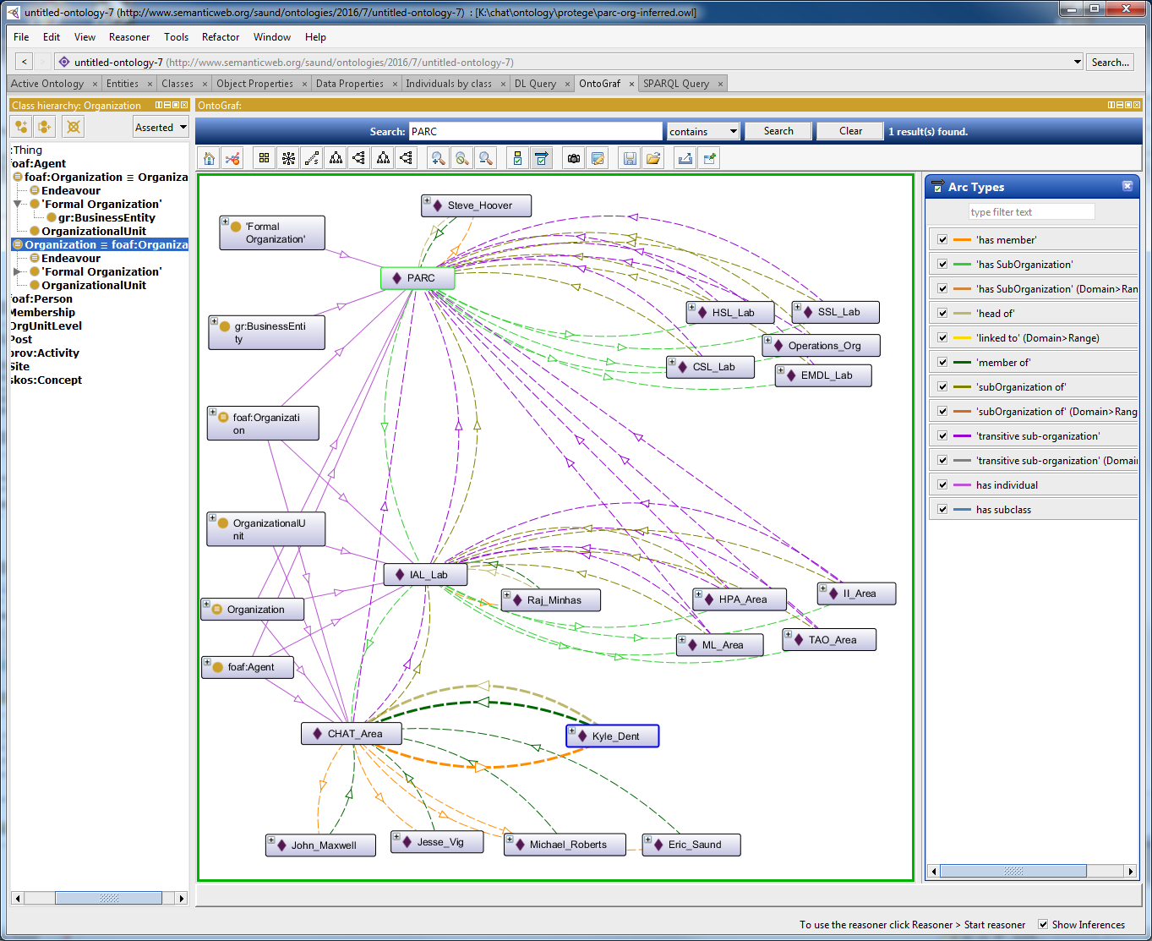
Knowledge Base (4)
PARC Partial Ontology : links entered in Protege + inferred by HermiT

Slide 110
Project Proposal Sketch
Knowledge Base of PARC Organization in an OWL Ontology
Mix in other ontologies: e.g. VCard, Calendar, Building Layout
Conversational interfaces using Otto-type dialog management
Extend to:
additional PARC resources and services, e.g. Deltek, Outlook calendaring
process help
workflow assistance
Questions and Issues

Slide 111
Conversational Interfaces using Otto-type Dialog Management
Example multi-utterance dialogs based on org-chart knowledge:
U: “Is Jon Smith in the TWA Area?”
A: “Yes, Jon Smith is in the TWA Area”
U: “Then who does he report to?”
A: “Jon Smith reports to Susan Jones, who is the manager of the TWA Area”
U: “Who else reports to Susan Jones?”
A: “Eight other people report to Susan Jones. Would you like me to list them?”
U: “No that’s all right.”
U: “A new member joined the TWA Area”
A: “Okay, I’ll enter it in the database.
What is the new member’s name?”
U: “Jon Schneidermann”
A: “Is the first name spelled J O H N ?”
U: “No, it’s J O N.”
A: “Okay, J O N.
Please spell out the last name for me”
U: “S C H N E I”
A: “S C H N E I”
U: “D E R M A N N”
A: “D E R M A. Is that two N’s?”
U: “Yes”

Slide 112
Project Proposal Sketch
Knowledge Base of PARC Organization in an OWL Ontology
Conversational interfaces using Otto-type dialog management
Extend to:
additional PARC resources and services, e.g. Deltek, Outlook calendaring
process help
workflow assistance
Questions and Issues

Slide 113
Extensions
Deltek “Fill out my time card for one hour on a PARC meeting and seven hours on CAPA” “How much budget is left in account 3410?”
Outlook Address Book “Is Conference Room 2507 free at 2:00pm this afternoon”
Telephone system U: “Leave a message for all members of the CHAT Area” A: “Okay. What is the message?”
Process Help A: “After you fill out the form, print it out and give it to your admin.” U: “Who might that be?” A: “The admin for the TWA area is Jon Smith.”
Workflow Assistance U: “Who still has to sign my purchase order for Extrophoretic Biterbi Brackets?” A: “That P.O. has been signed by your manager but is awaiting approval by Import/Export controls.” U: “Who has to sign it there?” A: “The document was routed to Jon Smith. He is on vacation until May 20th” U: “Who else in that department can sign it?” A: “Only the department manager, Susan Jones.” U: “Please route the document to her then.”

Slide 114
Project Proposal Sketch
Knowledge Base of PARC Organization in an OWL Ontology
Conversational interfaces using Otto-type dialog management
Extend to:
additional PARC resources and services, e.g. Deltek, Outlook calendaring
process help
workflow assistance
Questions and Issues

Slide 115
Questions and Issues (1)
Where is reasoning and inference done? - in the OWL inference engine - in the logic of dialog management - some other reasoning engine
Product viability
functionality
threshold of adoption
usability
What is the pain that our tool alleviates?
e.g. “I need to know X to do my job.
It takes me forever to find it.”
Build a mockup first? - Shop among PARC personnel - Ask BD: Could you sell this?

Slide 116
Questions and Issues (2)
What is the shape of required dialog competency? -Logical Form intents -Logical form parameterizations of intents -Utterance variations -Single-turn vs. multi-turn dialogs -Complexity of dialog context that must be accounted for -Bot-ese controlled language
Can we tap into external office resources? - Deltek - MS Address Book, Calendar, on Exchange? - telephone system (ShoreTel, Twilio)
Where to implement V2 naturalistic conversational dialogue manager? - Otto : more cumbersome Java dev environment, more constraints, greater cognitive burden on new ideation and invention - Python: build on V1 (tell-phone-number), more nimble development, possible replication of existing Otto functionality, farther from deployment version
Knowledge modeling -OWL vs. more primitive RDF -The Organization Ontology vs. some other, our own
depth
bushiness

Slide 117
Determiners (3)
Entity:
N = 2
{quantifier-either} {entity-singular} either lab
ONE
Entity:
N > 2
{quantifier-any} {entity-singular} any lab
ONE
Entity:
N > 2
{quantifier-any} {entity-plural} any labs
ALL
{indefinite-article} {entity-plural} a labs
{singular-demonstrative}{entity-plural} this labs
that labs
{plural-demonstrative} {entity-singular} these lab
those lab
{quantifier-[quantity} {entity-plural} both lab
a few lab
several lab
many lab
most lab
all lab
{enumerator-each} {entity plural} each labs
{enumerator-every} {entity plural} every labs
Entity:
N =
.........
Ungrammatical
As listeners, we tend to interpret an ungrammatical expression like “this labs”
as a grammatical one, namely {singular-possessive}{entity-singular} “this lab’s”
For speech input which may lack apostrophes, we will need to entertain this
alternative.

